Slide 1

Sponsor:
Skyelar Head
Professor:
Dr. Kevin Nowka
Team members:
Kelton Chesshire
Holden Haile
Abhi Singh
Teaching Assistant: Sambandh Dhal

Slide 2
Project Description - Background
In the U.S. Alone over 10% of the population suffers from Diabetes. This group has been the inspiration for many devices that make checking blood sugar simple and consistent, but none to help maintain their daily glucose intake.

Slide 3
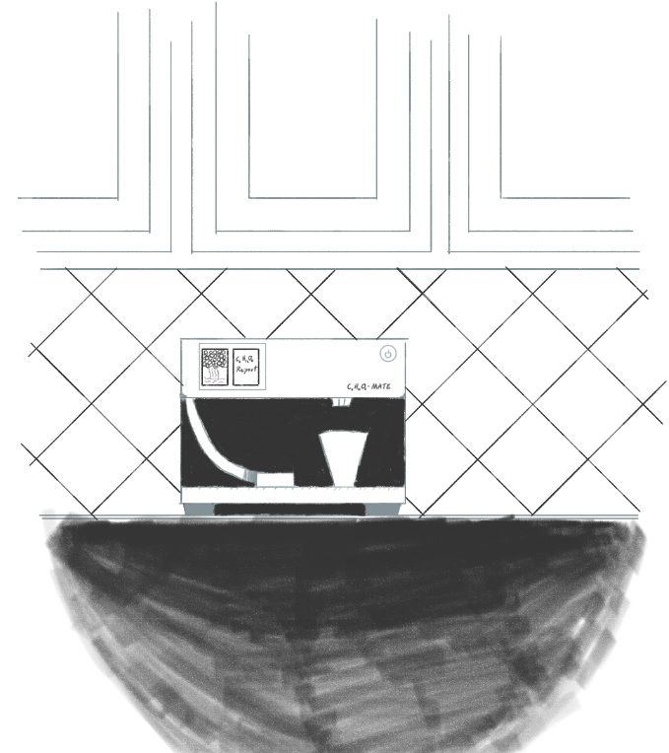
Project Description - Solution Proposal
Develop a device that can dispense carbs
consistently
accurately
easily-consumable manner so that users can accurately manage their glucose levels.

Slide 4
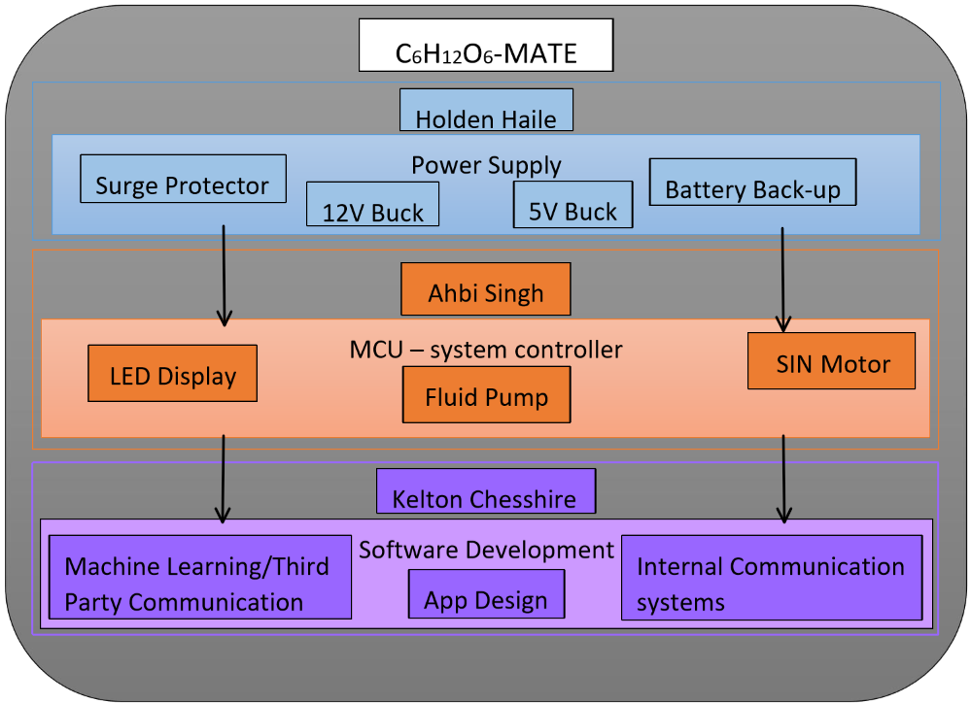
Flow Chart of Subsystems

Slide 5
Power Supply Status | Buck Converter Schematic Design | Buck converter parts order | Proto Board construction | Proto Board testing | PCB Design
Microcontroller Status | Dispenser Proof of Concept & Barebones Networking | MQTT Broker setup & Testing with Dispenser | Nextion Display Interface setup | Dispenser Housing & Dispensing Accuracy | Stock Level check & MQTT multi topic messages
Software Status | Application UI Development | Application Authentication Backend

Slide 6
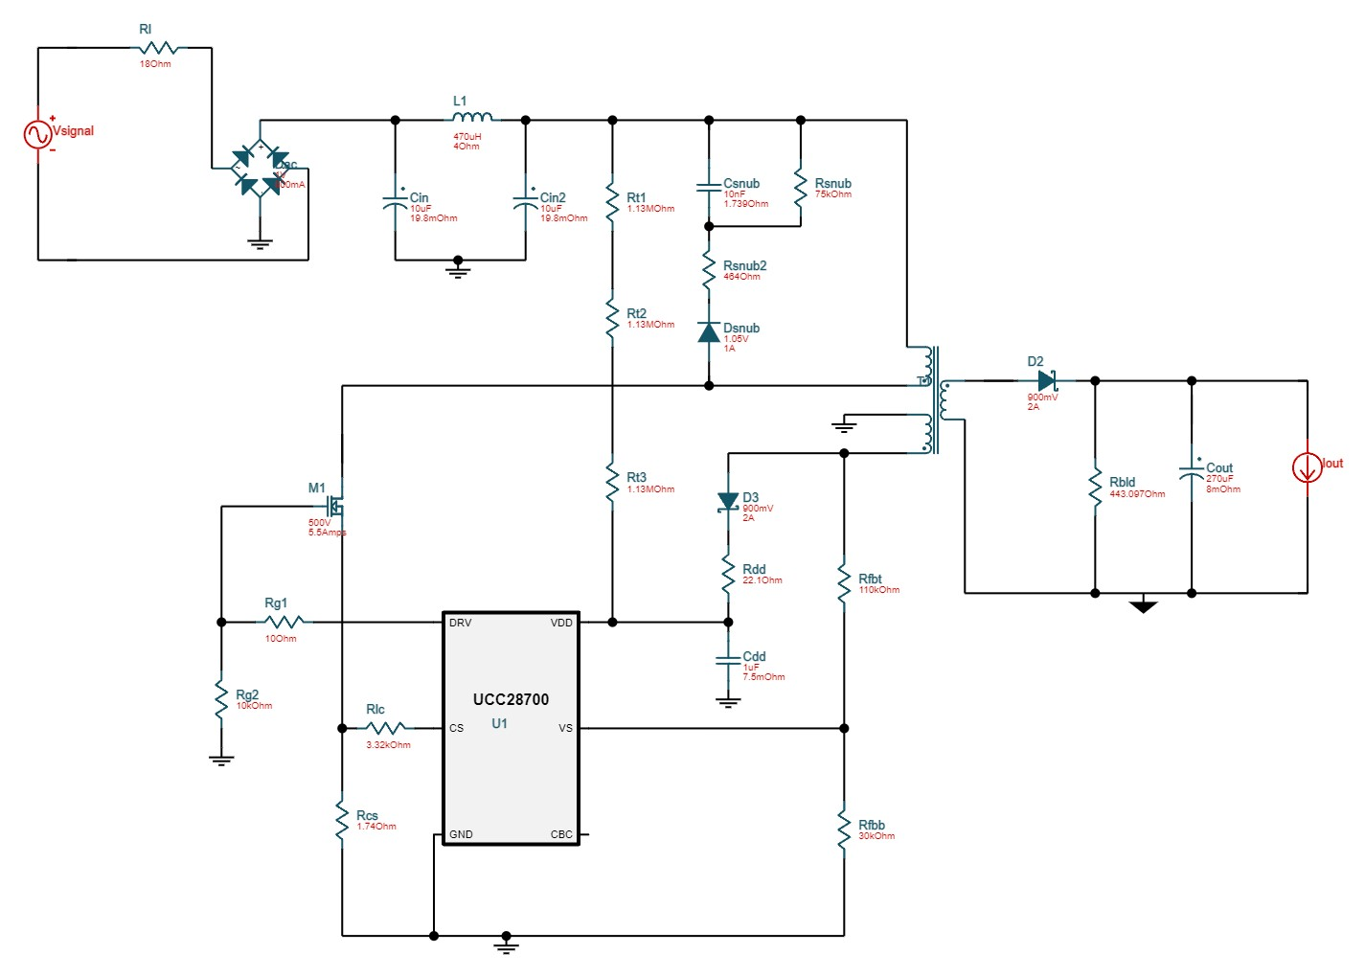
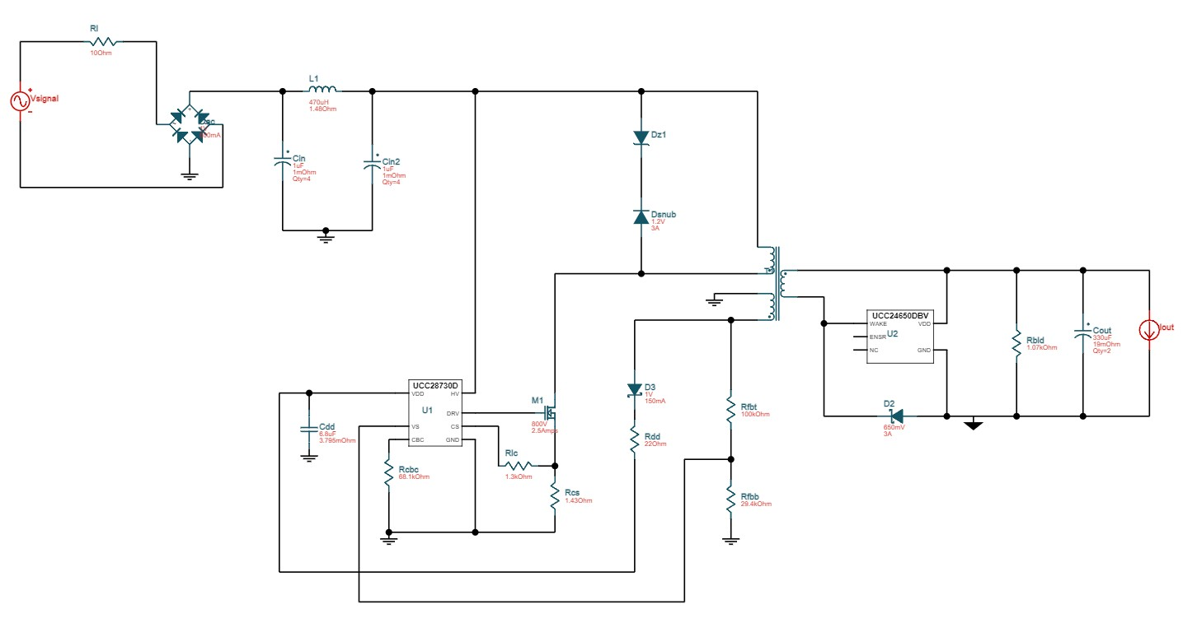
Power Supply Holden Haile
Finalized Design of Both Buck Converters - 17 Hrs | Ongoing progress/problems and plans until the next presentation
adjusted designs to accommodate changes in hardware finalized designs and produced schematics ordered parts for prototype board | Awaiting parts ordered (end of week) Beginning design of PCB Practice soldering using parts ordered

Slide 7
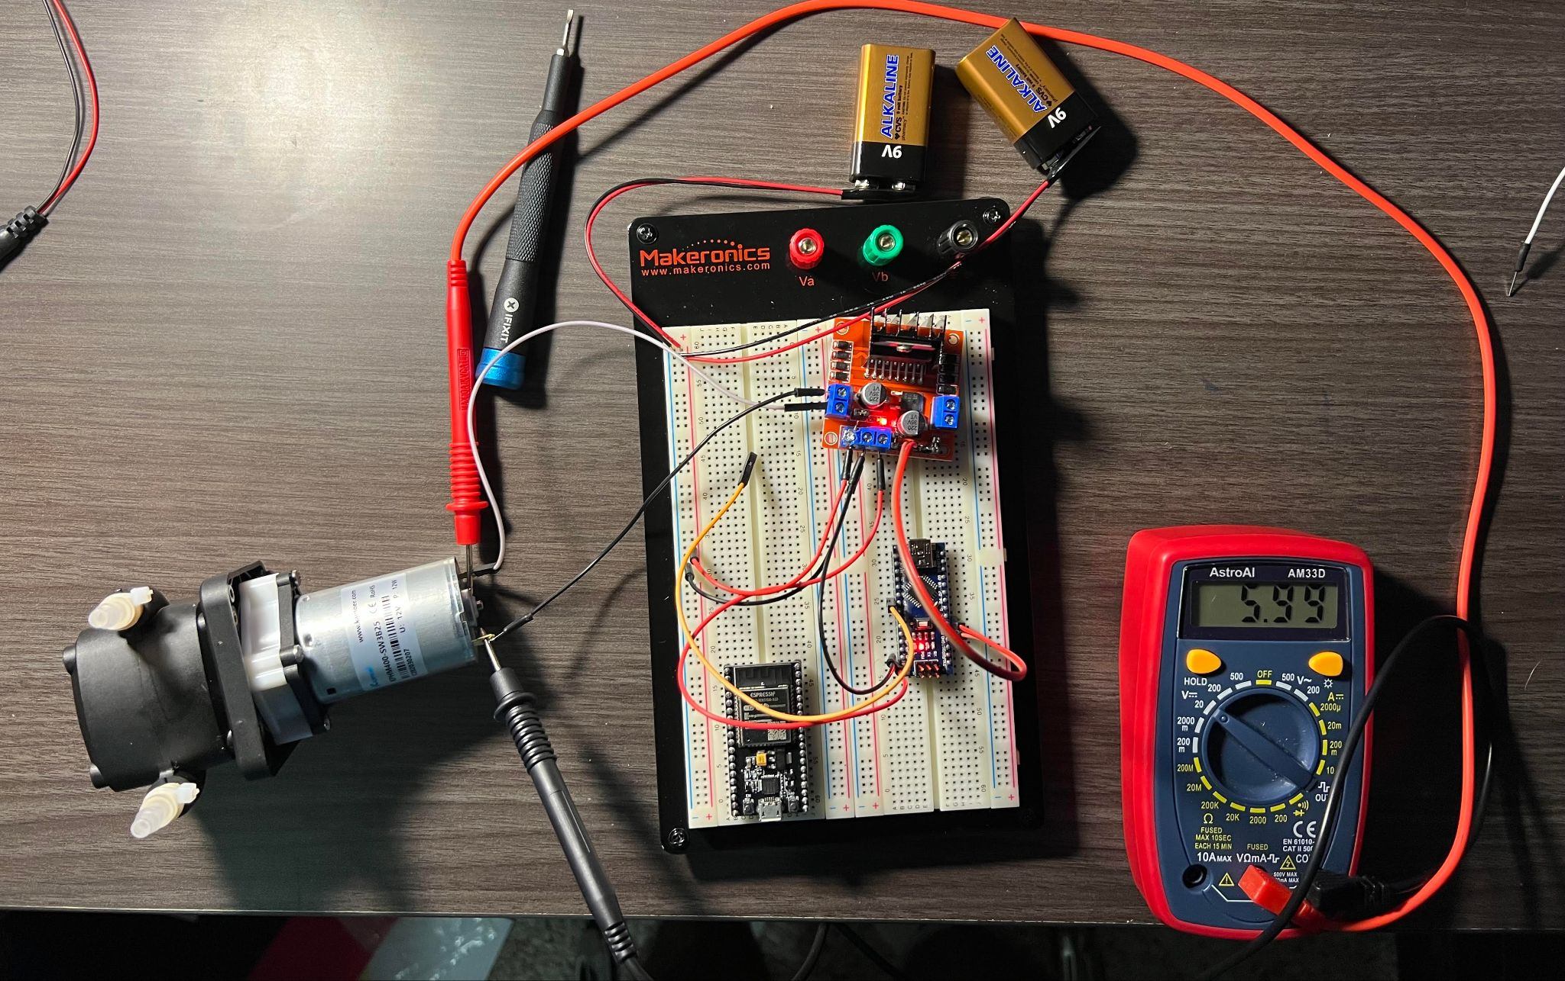
Dispensing System Abhi Singh
Dispenser Proof of Concept & WiFi 10 hrs | Ongoing progress/problems and plans until the next presentation
Peristaltic pump PWM testing with arduino nano and L298N motor controller esp32 network connection (Wi-Fi) achieved | setting up MQTT broker and testing dispense commands skittle dispenser test with actuator Dispenser housing design in SolidWorks

Slide 8
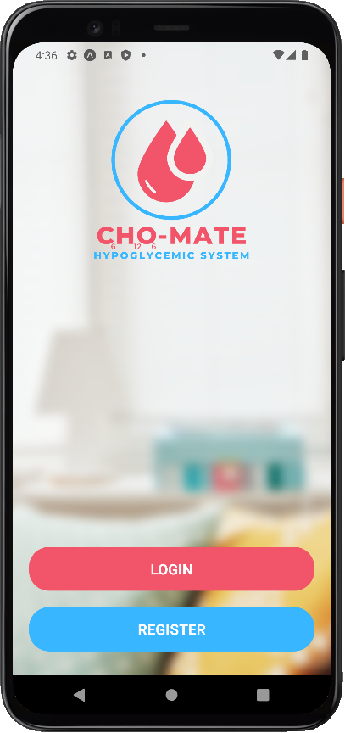
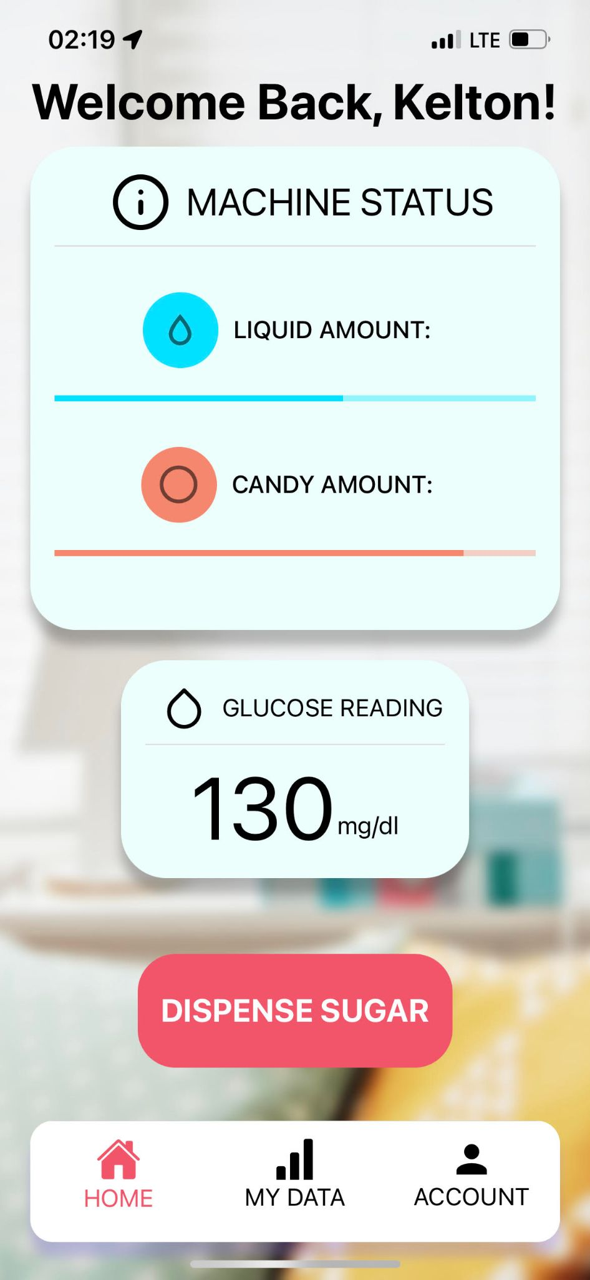
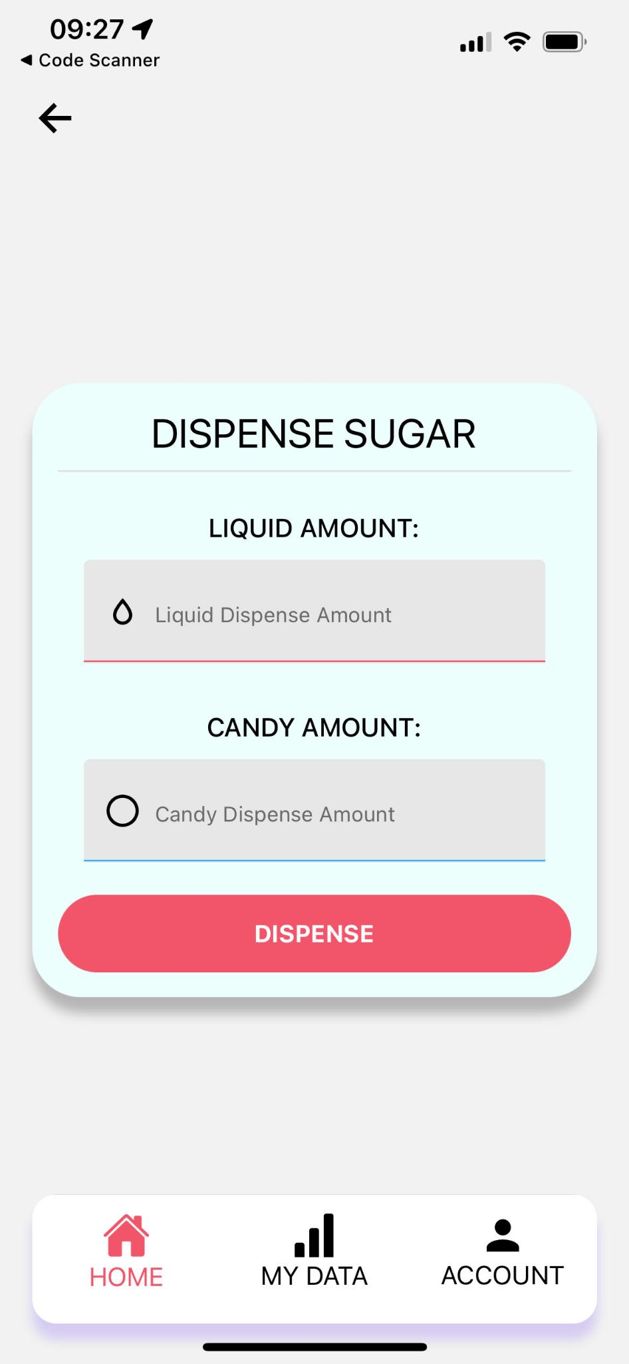
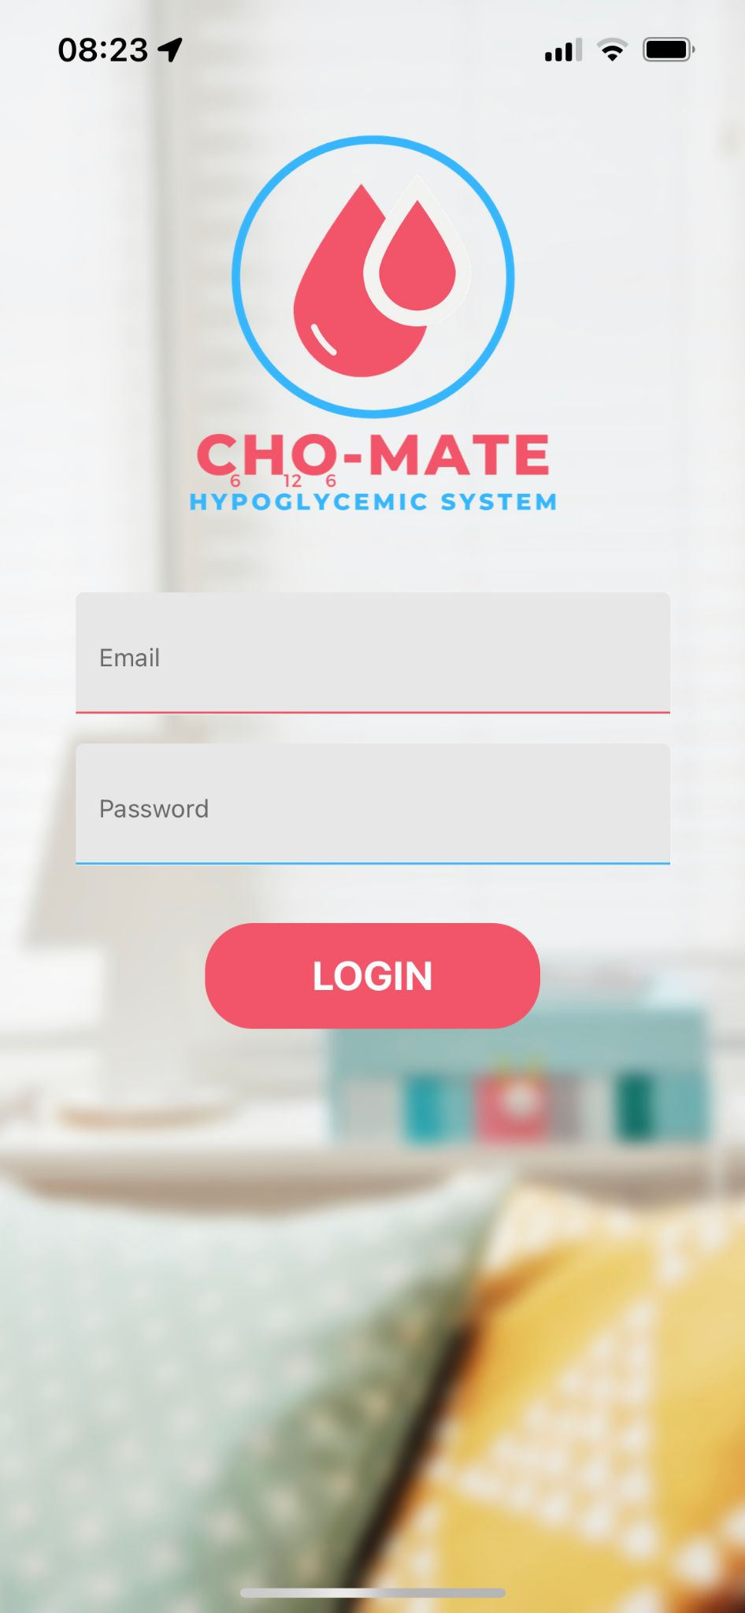
Mobile Application Kelton Chesshire
Accomplishments since the last presentation 14 hrs | Ongoing progress/problems and plans until the next presentation
Basic Application UI Library UI screens Application Form Validation and Authentication | Further backend development Connection between application and Raspberry Pi testing system using MQTT Glucometer connection Push Notifications

